Slide 1



RSA KEY GENERATOR
CYBER SECURITY PROJECT
Implementing Asymmetric Cryptography
Presenter:
Usaira Shahbaz NUM-BSCS-2022-27
Junaid Ameer Khan NUM-BSCS-2022-46
Rana Muhammad Adeel NUM-BSCS-2022-12
Instructor:
Prof. Dr. Mudassar Raza

Slide 2
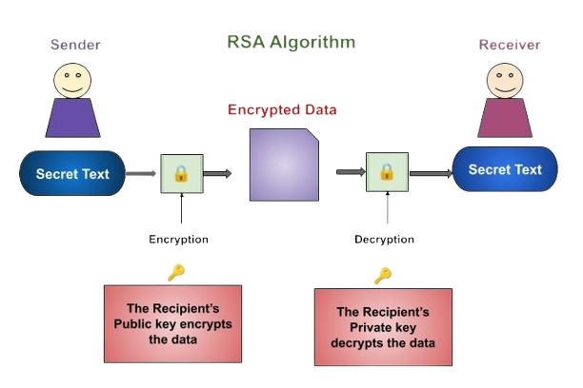
Introduction to RSA
What is RSA?
Rivest–Shamir–Adleman (RSA) is a foundational public-key cryptosystem for secure data transmission.
It remains one of the most widely used asymmetric algorithms in modern secure communications.
Why Asymmetric Encryption?
Uses a key pair: a public key for encryption and a private key for decryption.
Solves the key exchange problem by allowing secure communication without sharing a secret key beforehand.

Slide 3

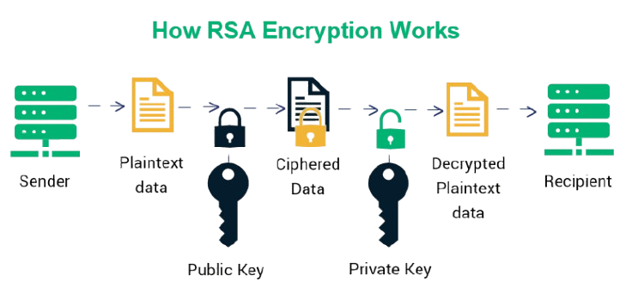
Core Concepts
Public-Key Cryptography
Key Pair
Process Flow
A system using pairs of keys: public keys for encryption (widely shared) and private keys for decryption (kept secret).
Mathematically linked keys where data encrypted with the public key can only be decrypted by the corresponding private key.
Plaintext → Encryption (Public Key) → Ciphertext → Decryption (Private Key) → Plaintext.

Slide 4
Why RSA is important?
Used in:
SSL/TLS
Secure email (PGP)
Digital signatures
Secure authentication
Based on the difficulty of prime factorization
Provides strong security when large key sizes are used

Slide 5
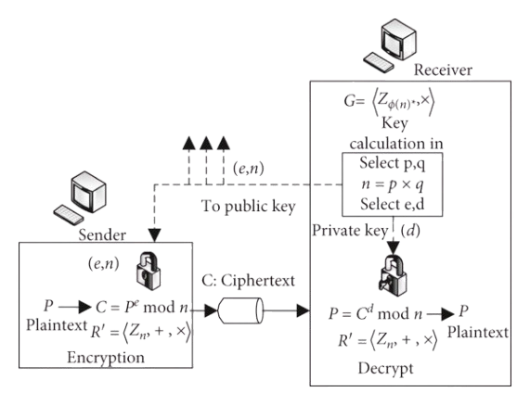
Mathematical Foundations: Key Generation
1. Prime Number Selection
Choose two distinct large prime numbers p and q. Security depends on the difficulty of factoring their product.
Miller-Rabin Primality Test
2. Compute the Modulus (n)
The product of the two primes forms the modulus for both keys.
n = p × q
3. Euler's Totient Function φ(n)
Calculate the number of positive integers less than n that are coprime to n.
φ(n) = (p - 1)(q - 1)

Slide 6

Mathematical Foundations: Key Generation
4. Public Exponent (e)
1 < e < φ(n) AND gcd(e, φ(n)) = 1
Choose an integer e that is coprime to φ(n). Common choices include 3, 17, or 65537 for computational efficiency.
5. Private Exponent (d)
d ≡ e⁻¹ (mod φ(n))
Calculate d as the modular multiplicative inverse of e modulo φ(n). This ensures that (d × e) mod φ(n) = 1.
Resulting Key Pair
Public Key: (e, n)
Private Key: (d, n)

Slide 7
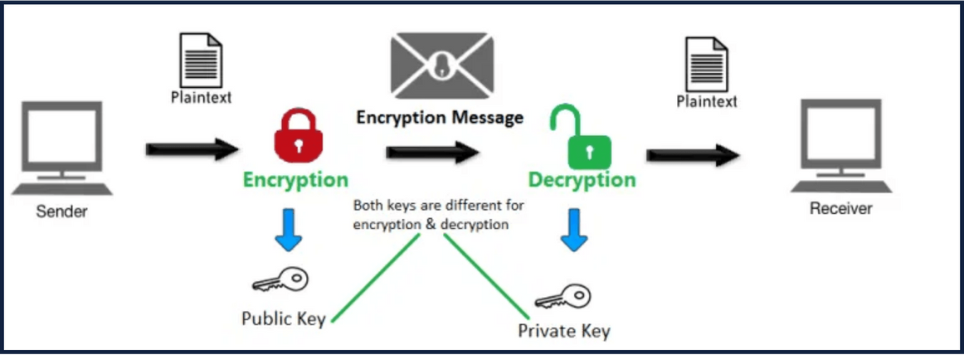
Mathematical Foundations - Encryption
C = Mᵉ mod n
C
The resulting Ciphertext
M
The Plaintext message (where 0 ≤ M < n)
e
The Public Exponent
n
The Modulus (p × q)
Visualizing the Encryption Transformation

Slide 8
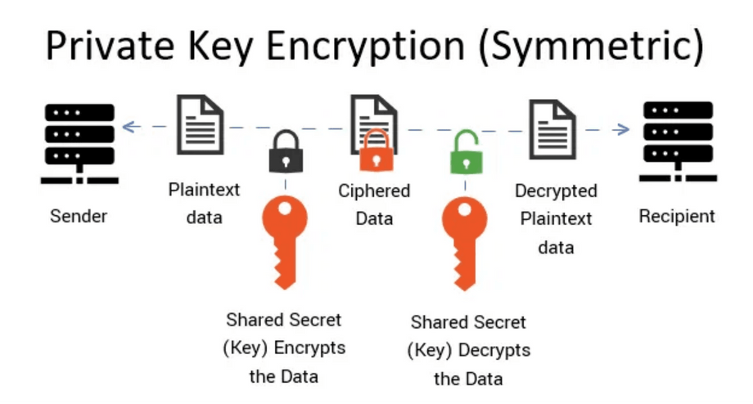
Mathematical Foundations - Decryption
M = Cᵈ mod n
M
The recovered Plaintext Message
C
The Ciphertext received
d
The Private Exponent (kept secret)
n
The Modulus (part of the key pair)
Visualizing the Decryption Flow with Private Key

Slide 9
Key Features
01 SECURITY
02 PRIVACY
RSA Key Pair Generation
Message Encryption
Automated generation of cryptographically secure public and private key pairs with customizable bit-lengths for varying security requirements.
Seamless transformation of plaintext messages into secure ciphertext using the recipient's public key, ensuring data confidentiality.
03 ACCESS
04 RELIABILITY
Message Decryption
Verification & Testing
Robust recovery of original plaintext from ciphertext using the corresponding private key, maintaining the integrity of the communication loop.
Integrated suite of automated test cases to verify the mathematical correctness and operational reliability of the encryption/decryption cycle.

Slide 10
Optional Features
Message Padding (PKCS#1)
File-Based Key Storage
Performance Analysis
Implementation of PKCS#1 v1.5 padding schemes.
Persistent storage for generated key pairs.
Benchmarking key generation across sizes.
Prevents deterministic encryption vulnerabilities.
Support for standard formats (PEM/JSON).
Encryption/Decryption speed evaluation.
Ensures semantic security for small messages.
Secure loading and management of existing keys.
Comparison of 1024, 2048, and 4096-bit keys.
Security Enhancement
Key Management
Efficiency Metrics

Slide 11
Security Analysis
RSA security relies on:
Difficulty of factoring large numbers
Larger key sizes → higher security
Vulnerable if:
Small primes are used
Poor random number generation
Proper implementation is essential

Slide 12


Thank You

